Slide 1
Incineration and PCDD’F’s
Kees Olie
University of Amsterdam

Slide 2
The factors influencing upon dioxin generation in MSWI
Kees Olie
University of Amsterdam

Slide 3
Overview
Introduction
History
How we found dioxins in fly ash
What happens with the particles in the flue gas from the stack?
Formation of PCDD/F’s in municipal waste incinerators
Prevention of formation of PCDD/F’s in municipal waste incinerators

Slide 4
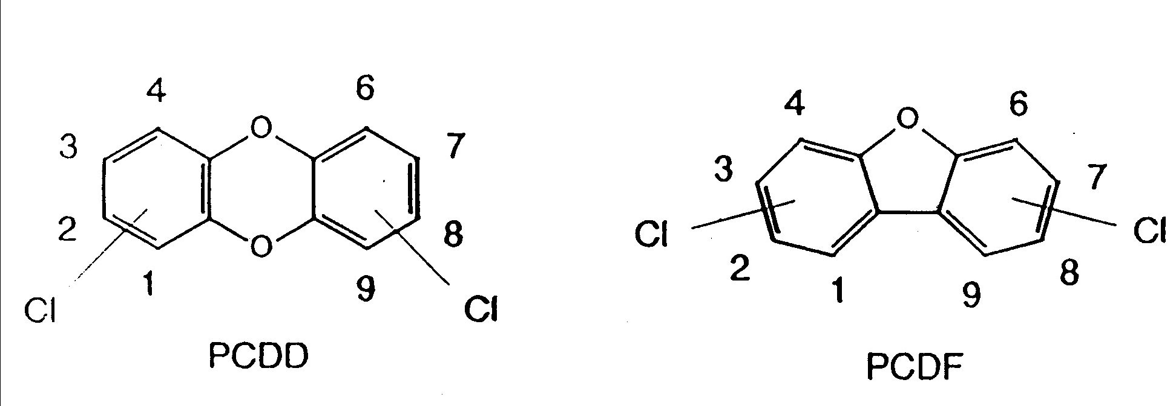
Introduction

Slide 5
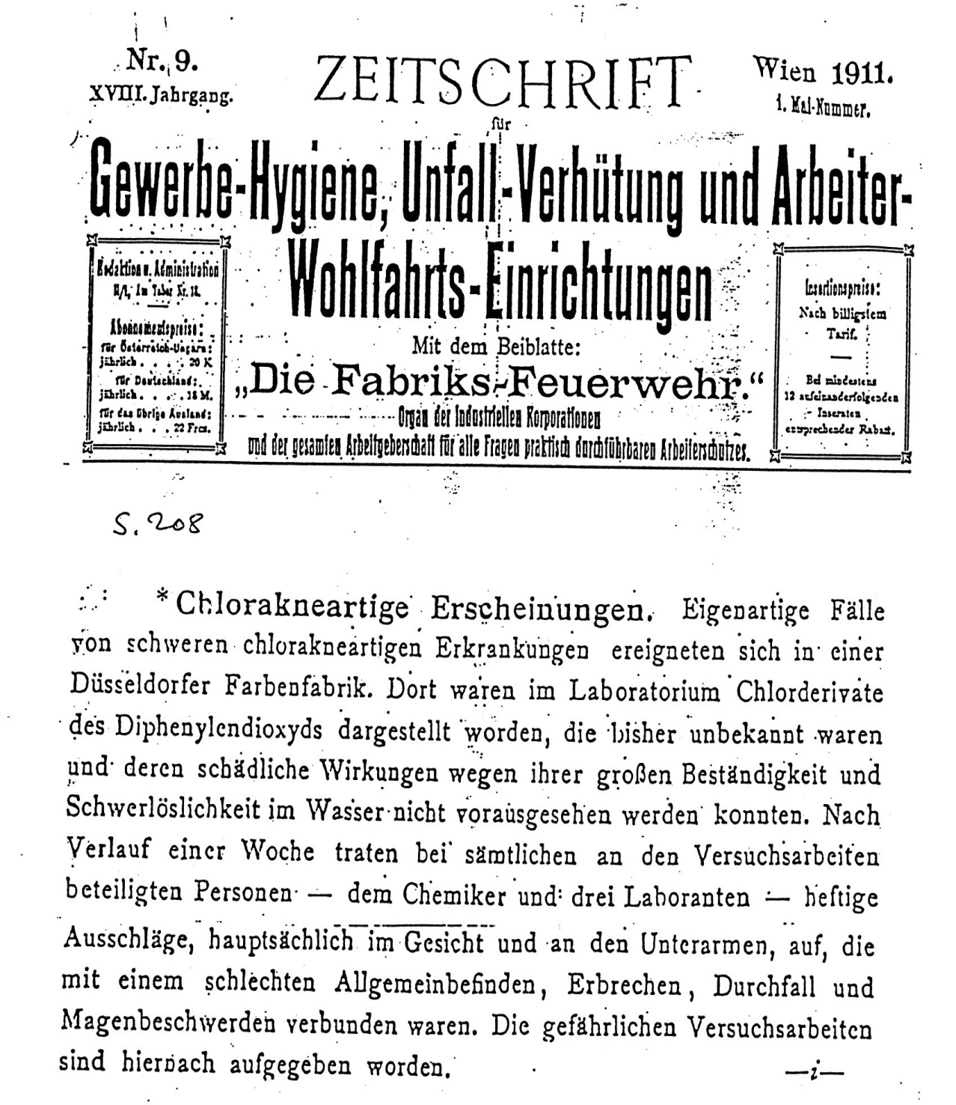

Slide 6
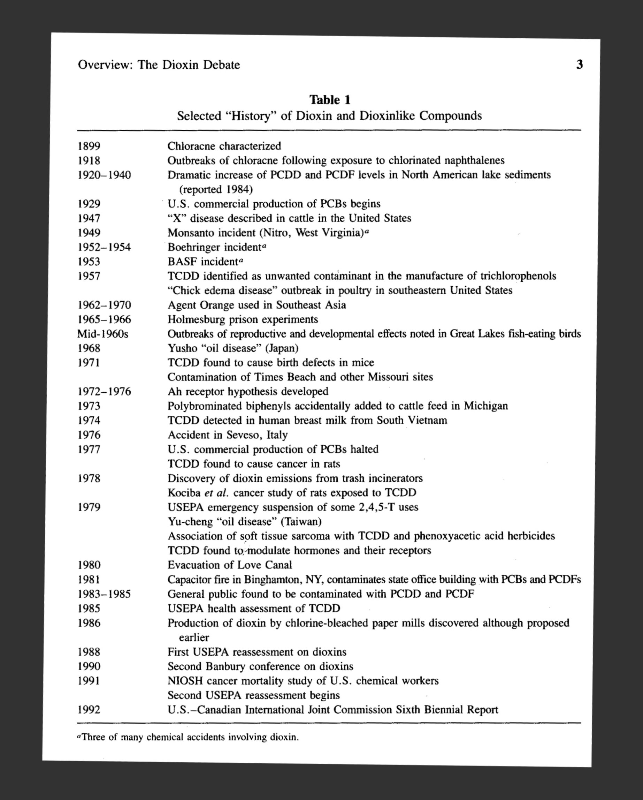

Slide 7
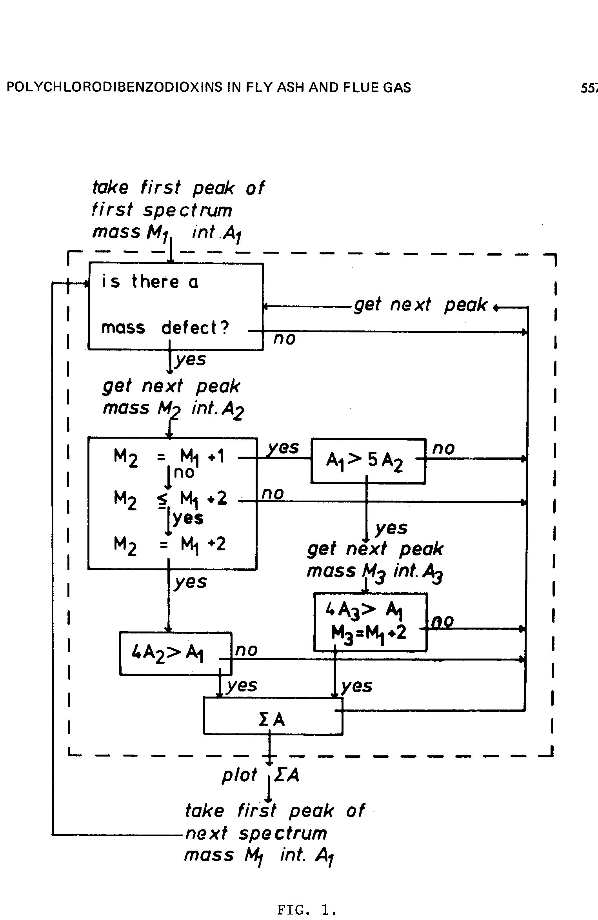
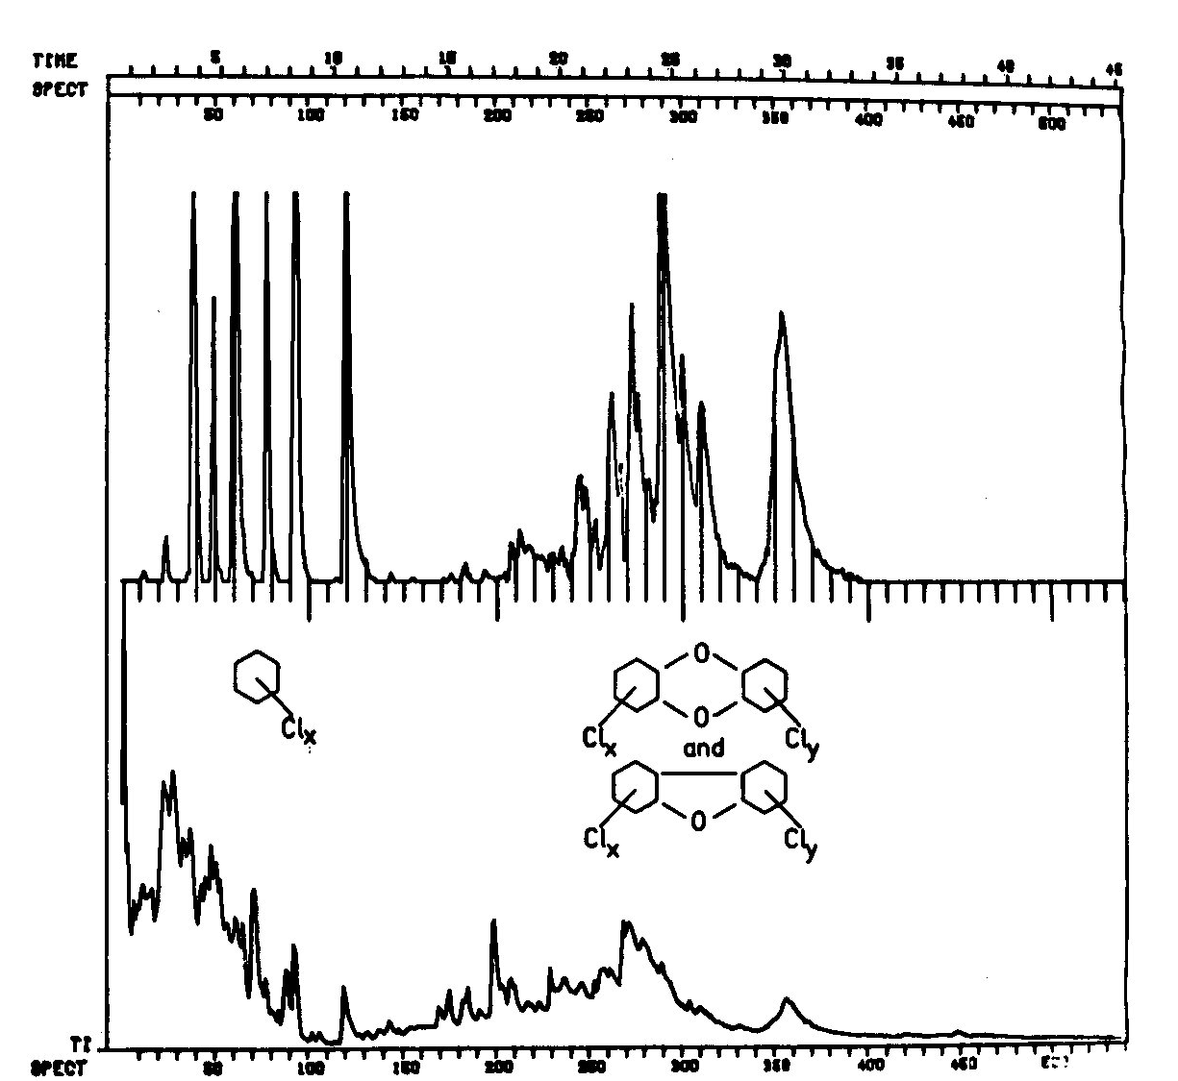
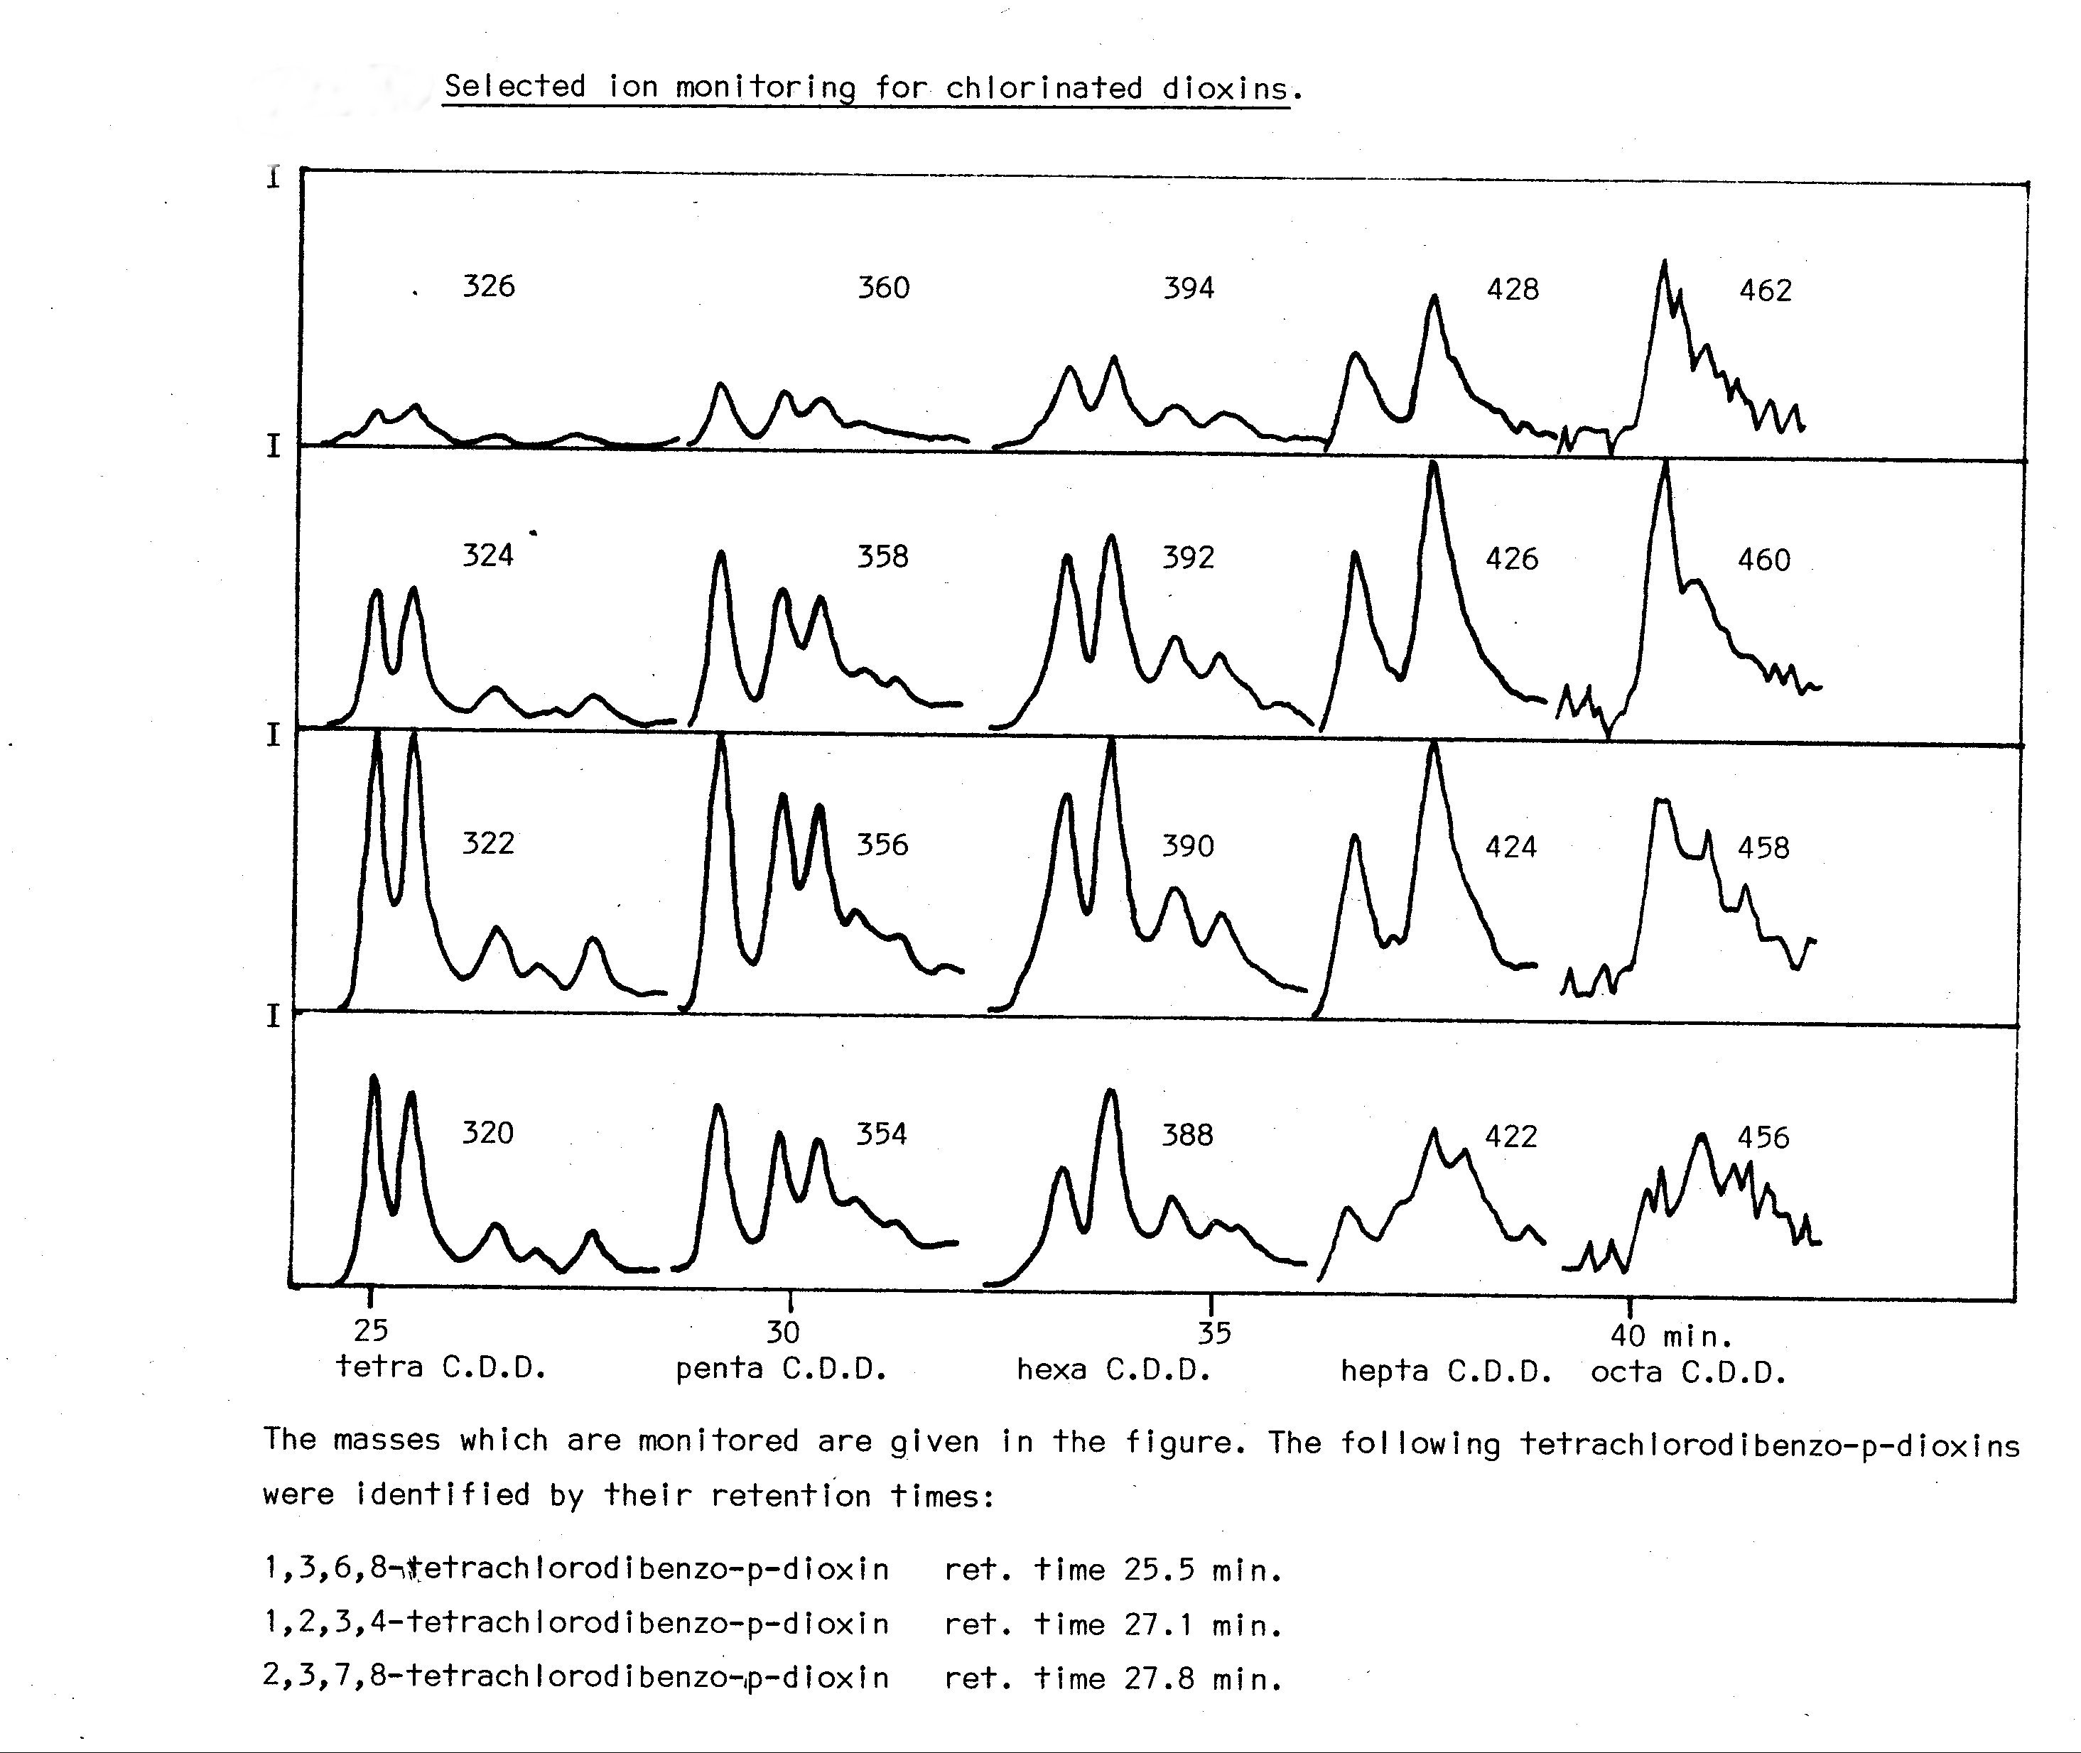
Detection of PCDD/F’s in incinerator emissions

Slide 8
Is there a risk?
Are the PCDD/F’s bioavailable
With animal experiments it was found that they are taken up from fly ash.
M. vandenBerg, K. Olie, and O. Hutzinger. Uptake and selective retention in rats of orally administered chlorinated dioxins and dibenzofurans from fly-ash and fly-ash extract. Chemosphere 12(4/5):537-544, 1983.
What is the expected deposition from an incinerator?
This can be calculated knowing wind direction , wind speed , stack height, flue gas temperature and assuming a certain mean particle size.
K. Olie, M. van den Berg, and O. Hutzinger. Formation and fate of PCDD and PCDF from combustion processes. Chemosphere 12(4/5):627-636, 1983.

Slide 9
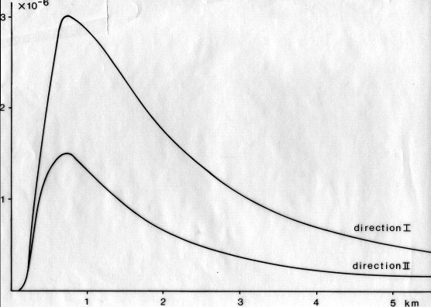
Distribution from the stack in 2 directions

Slide 10
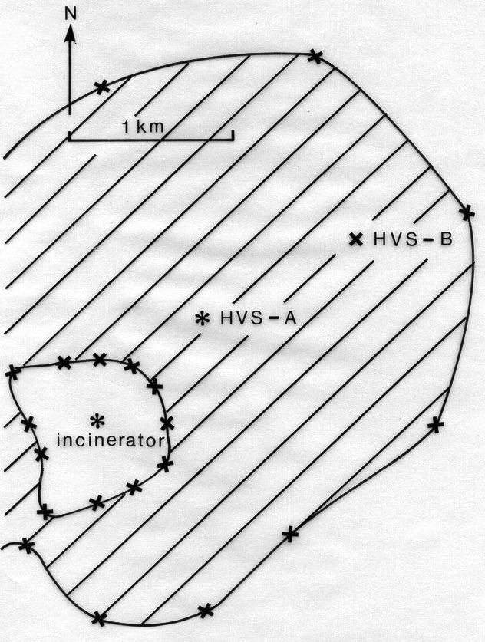
Prediction of areas with high levels of PCDD/F’s in grass

Slide 11
Cows milk
In 1989 it was found that cows milk near an incinerator did contain too high levels of PCDD/F’s
The milk was taken out of the market for many years.
The incinerator is upgraded in the meantime
Other incinerators were closed down

Slide 12

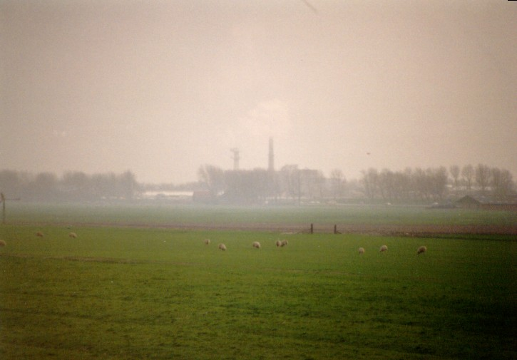
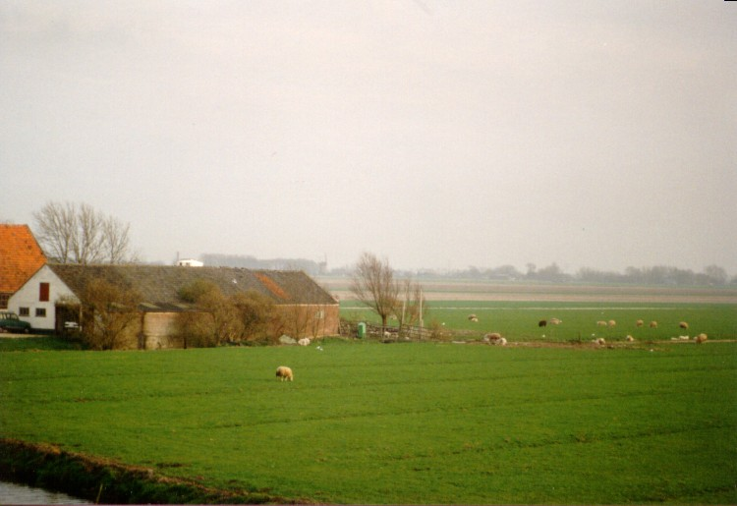

Old MSWI
Alkmaar

Slide 13
Formation of PCDD/F’s in municipal waste incinerators
Two theories of formation have been developed.
De novo does not explain how the catalyst can be reached.
Precursors don’t explain the isomer pattern.
Benzene and chlorinated benzenes are not precursors.
K. Olie, M. H. Schoonenboom, A Buijs, and R. Addink. Formation studies of PCDD's and PCDF's using stable isotopes (¹⁸O and ¹³C). Organohalogen Compounds 23:329-334, 1995.

Slide 14
Formation of PCDD/F’s in municipal waste incinerators
Two theories of formation have been developed.
De novo does not explain how the catalyst can be reached.
Precursors don’t explain the isomer pattern.
Benzene and chlorinated benzenes are not precursors.
K. Olie, M. H. Schoonenboom, A Buijs, and R. Addink. Formation studies of PCDD's and PCDF's using stable isotopes (¹⁸O and ¹³C). Organohalogen Compounds 23:329-334, 1995.

Slide 15
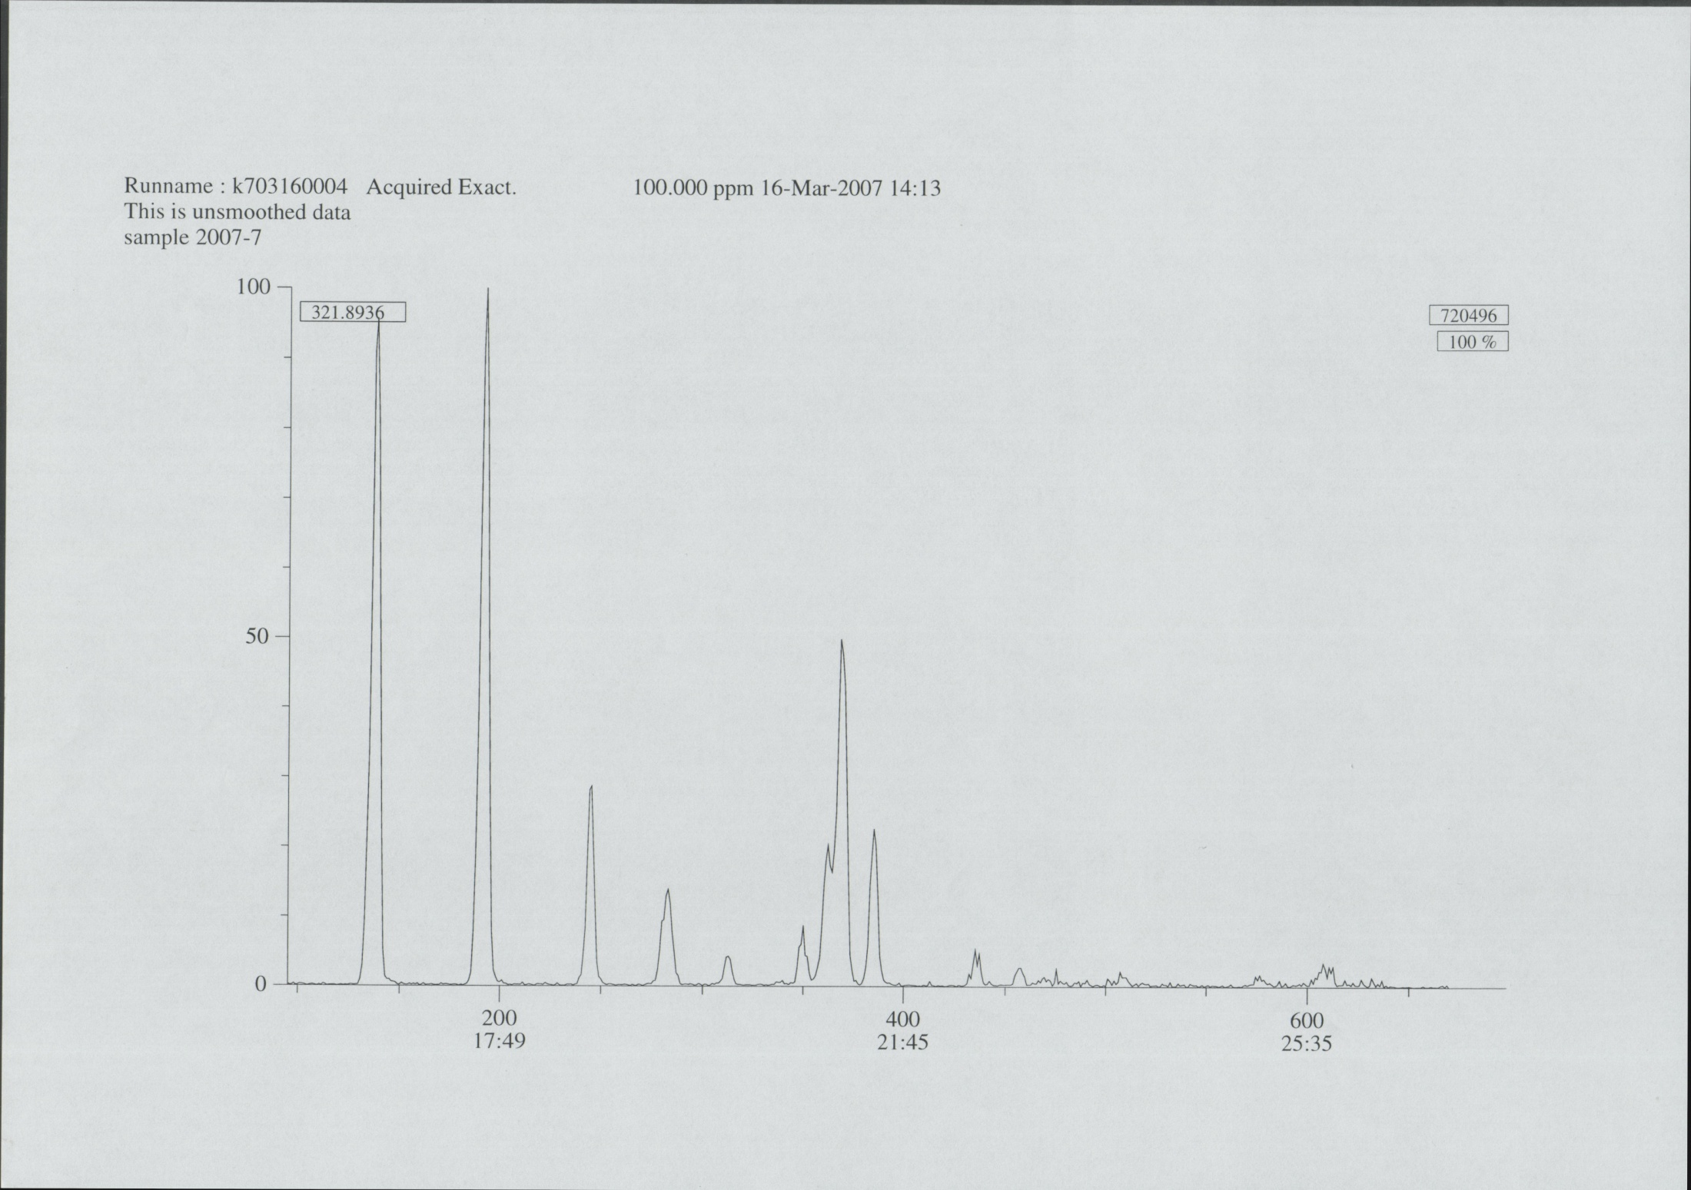

Slide 16
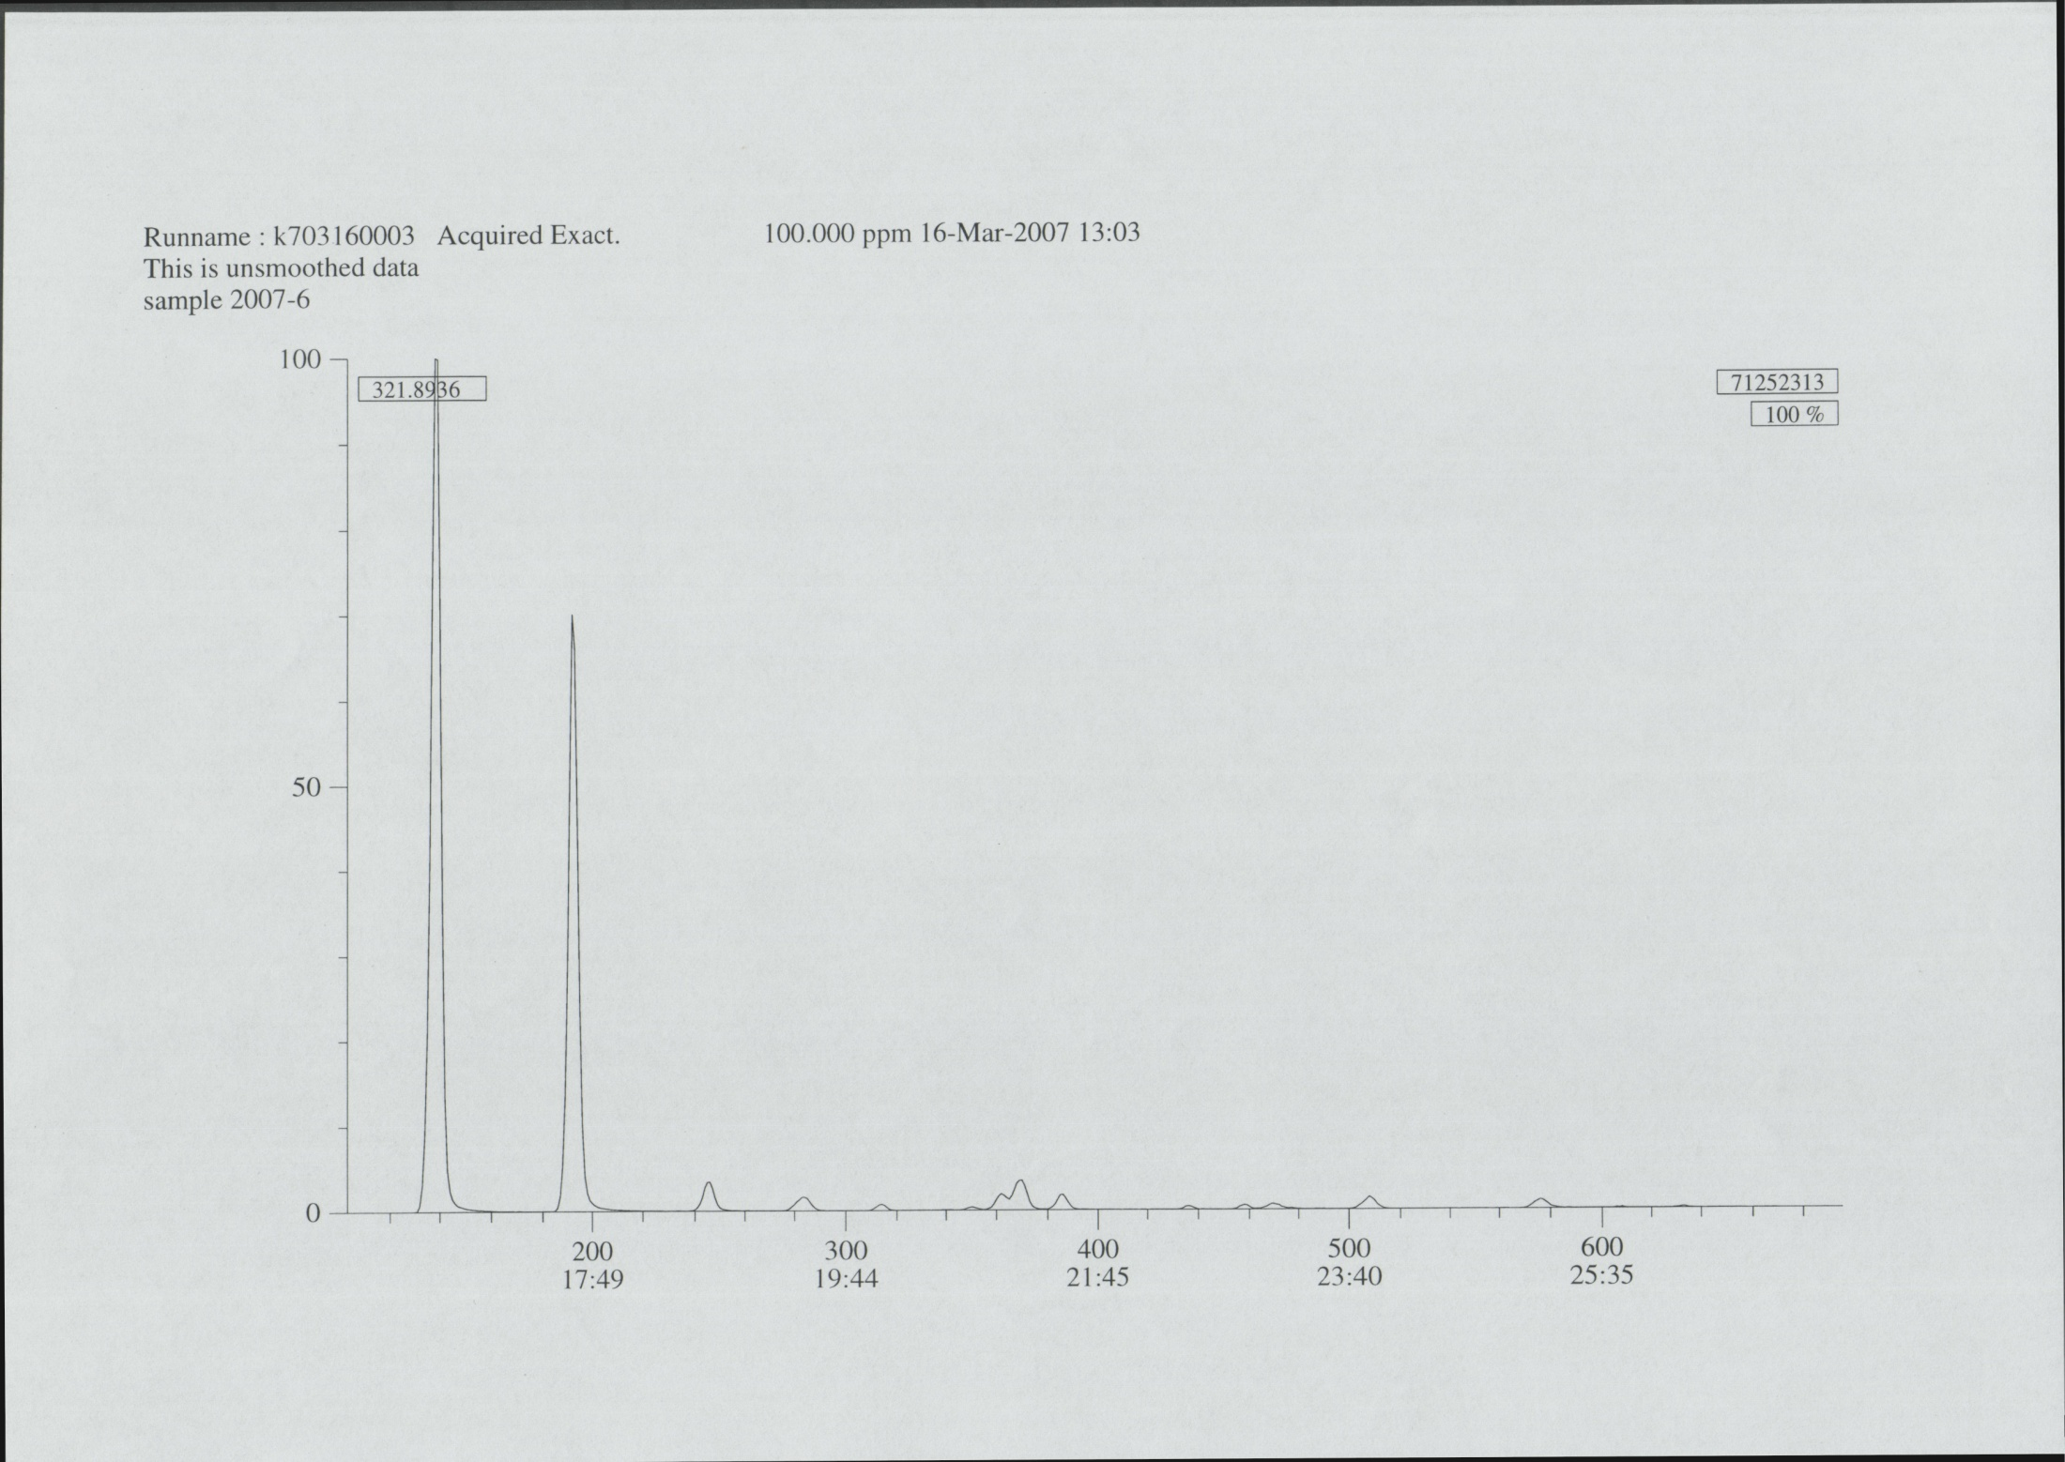

Slide 17
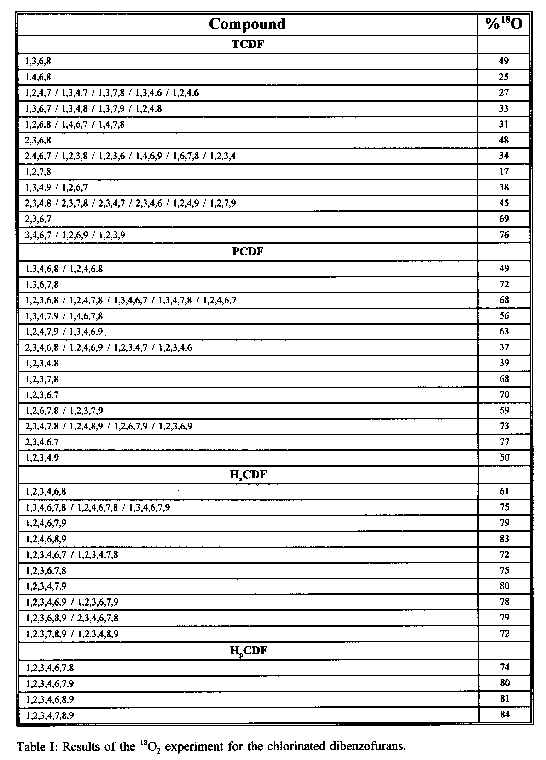

Slide 18
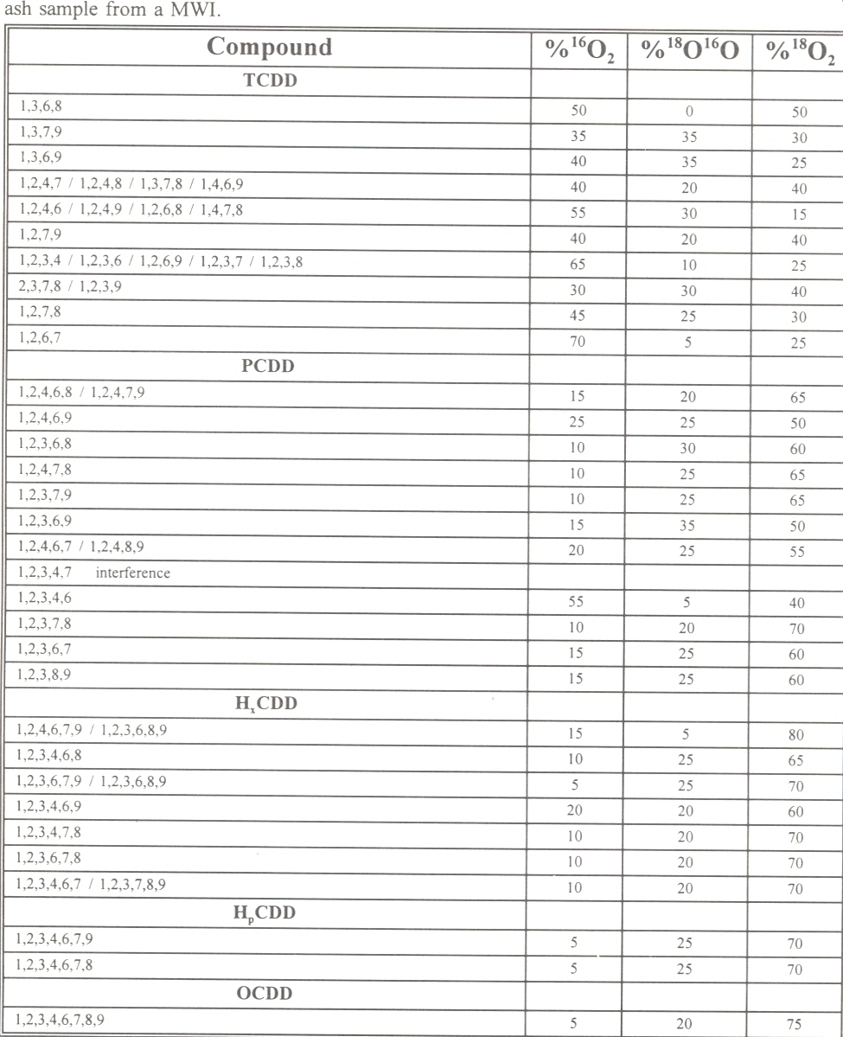

Slide 19
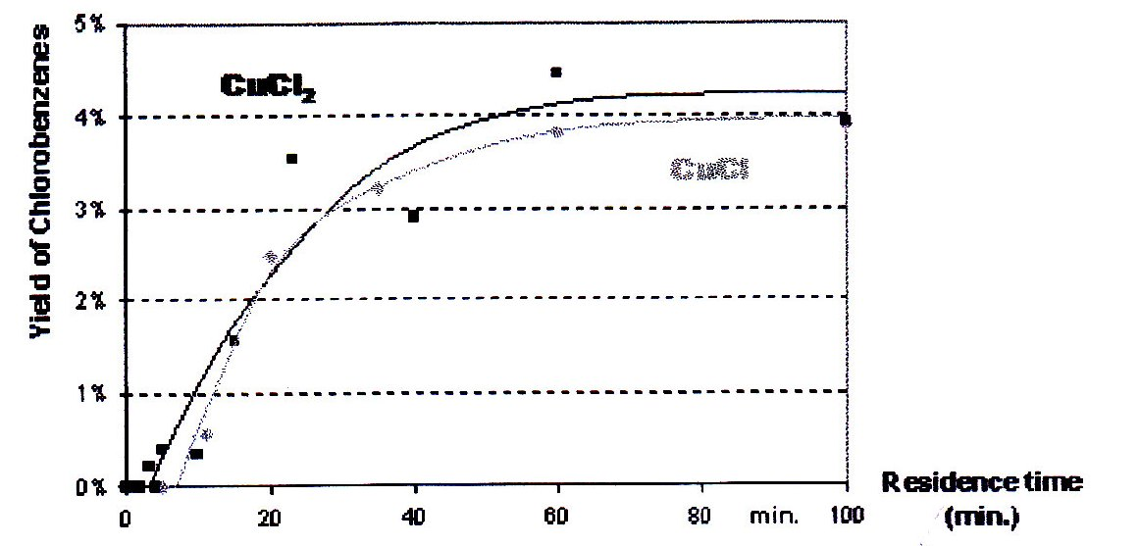
Correlation of PCDD/F’s and Clbenzenes
Nicolas, Visez, Jean-Pierre, Sawerysyn. On the thermal degradation of PCDD/Fs promoted by CuCl or CuCl2 at 350°C. Organohalogen compounds vol 67 (2005)

Slide 20
Prevention of formation in municipal waste incinerators
A catalyst is responsible for the formation of PCDD/F’s .
“poisoning” of the catalyst can prevent the formation of PCDD/F’s
R. Addink, R. H. W. L. Paulus, and K. Olie. Prevention of polychlorinated dibenzo-p-dioxins/ dibenzofurans formation on municipal waste incinerator fly ash using nitrogen and sulfur compounds. Environ.Sci.Technol. 30:2350-2354, 1996.
Hunsinger, H, Seifert, H, Jay, K (2006), AN ECONOMIC PROCESS TO INHIBIT PCDD/F FORMATION IN MSWI BY SO2 . Organohalogen compounds 2006 (on the internet)
Co-firing waste and coal ???

